Slide 1
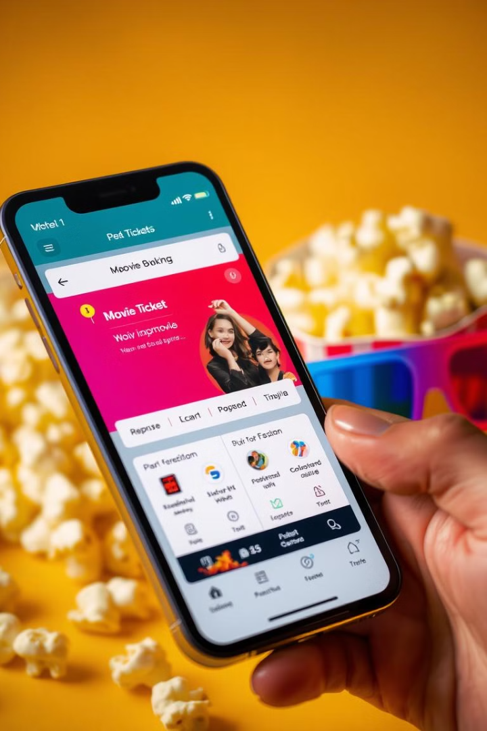
Movie Ticket Booking App
The project aims to develop a movie ticket booking and discovery platform that addresses key issues such as hidden fees, inefficient seat selection, and slow performance. It will offer AI-driven recommendations, real-time seat booking, and secure payment methods to enhance the user experience. Additionally, the platform will integrate blockchain technology to prevent fraud and improve movie discoverability.

Slide 2
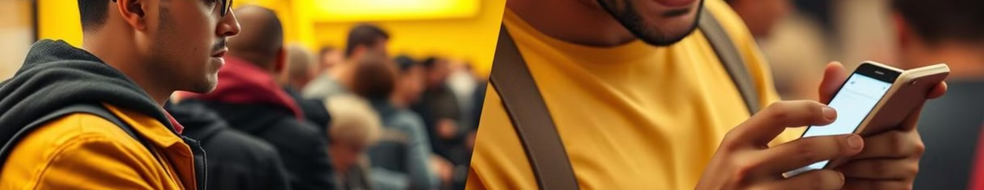



Motivation and Problem Statement
Streamline Booking Process
Enhance User Experience
Increase Booking Efficiency
Eliminate long queues and cuts time with Hidden Charges.
Provide a seamless, user-friendly interface for browsing and booking.
Optimize seat allocation and reduce traffic in booking.

Slide 3
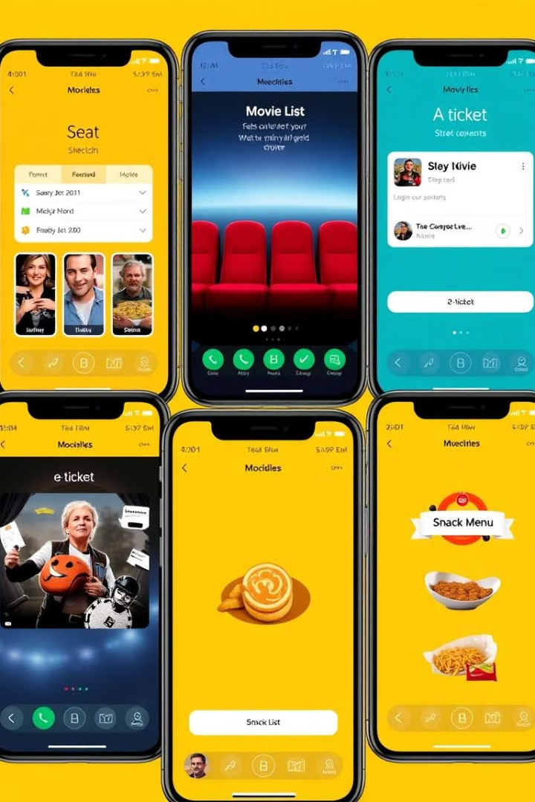




Key Features of the App
Movie Schedules
Seat Selection
E-Tickets
Real-time updates on showtimes and availability.
Interactive seating charts for personalized choices.
Convenient digital tickets with QR codes.
Snack Pre-ordering
Skip concession lines with in-app food orders.

Slide 4




Technology Stack and Architecture
React.js + Vit
1
Fast, efficient frontend development.
Spring Boot Backend
2
Robust server-side processing.
MongoDB
3
Flexible, scalable database solution.
RESTful API
4
Seamless communication between components.

Slide 5
User Interface Design and User Experience
Intuitive Navigation
Responsive Design
Accessibility Features
Simple, clean layout for easy browsing. Clear icons and minimal clicks required.
Adapts seamlessly to various screen sizes. Consistent experience across devices.
High contrast mode and screen reader compatibility. Inclusive design for all users.

Slide 6
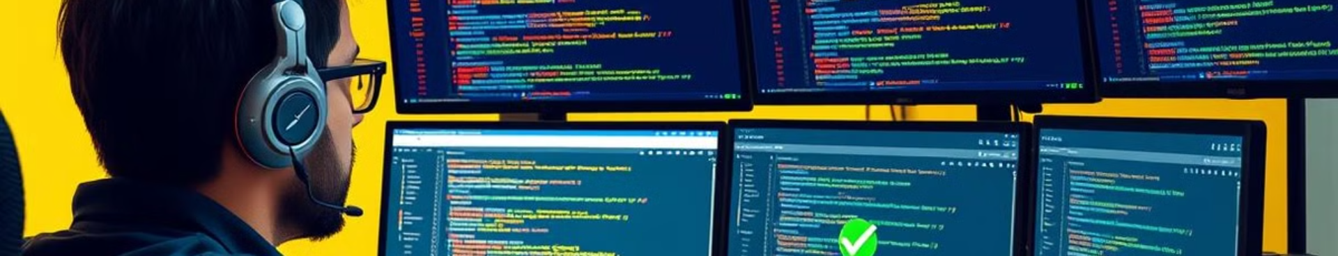
Testing and Deployment Strategies
Continuous Integration/Deployment
User Acceptance Testing
Integration Testing
Unit Testing
Verify seamless interaction between different parts.
Gather feedback from real users.
Automate build, test, and deployment processes.
Ensure individual components function correctly.

Slide 7

Challenges and Lessons Learned
Performance Optimization
State Management
Implemented lazy loading and code splitting to improve app speed.
Adopted Redux for better control of complex app states.
API Integration
User Feedback Integration
Overcame cinema data synchronization issues with custom middleware.
Iteratively improved UX based on beta tester insights.

Slide 8
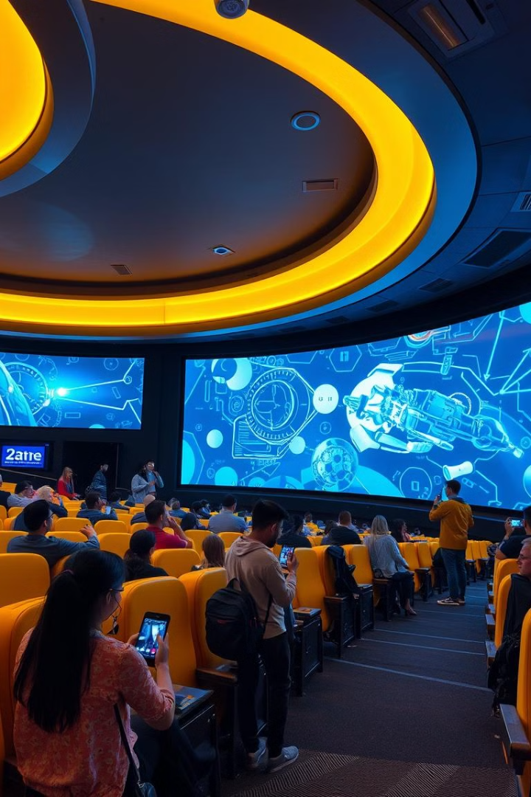



Future Enhancements and Conclusion
AI-Powered Recommendations
Personalized movie suggestions based on user preferences.
Social Integration
Allow friends to coordinate movie plans within the app.
Augmented Reality Seating Preview
Virtual theater experience for informed seat selection.
Our Movie Ticket Booking App is set to transform the cinema experience. We're excited about its potential and future growth!

